Slide 1

Project: MyNEU (Web and iOS application)
Course : User Experience and Testing
Guided By: Prof. Vishal Chawla

Slide 2
Work distribution
 | Click Stream Testing | A/B Testing | Card Sorting | Selenium | User Feedback/ personas | Eye Tracking | Story Boarding | Usability | IA | Prototype | Mobile
Deepti |  |  | ✓ |  |  |  | ✓ |  |  | ✓
Parima |  |  |  | ✓ | ✓
Pratik |  |  |  |  | ✓ | ✓ |  | ✓ | ✓ |  | ✓
Shilpi | ✓ | ✓ |  |  |  |  |  |  | ✓

Slide 3
Scope of the project
Used the bottom up approach to redesign the myNEU website with respect to all the 5 planes(strategy plane, scope plane, structure plane, skeleton plane, surface plane).
Created an information architecture for the website.
Created user flow diagram and story boarding for the application.
Developed wireframes for web and mobile application using Axure.
Implemented the following user research methods:
User surveys/ user personas
Card sorting
Click stream analysis
a/b testing
Eye tracking
User feedback
Selenium testing
Story Boarding

Slide 4
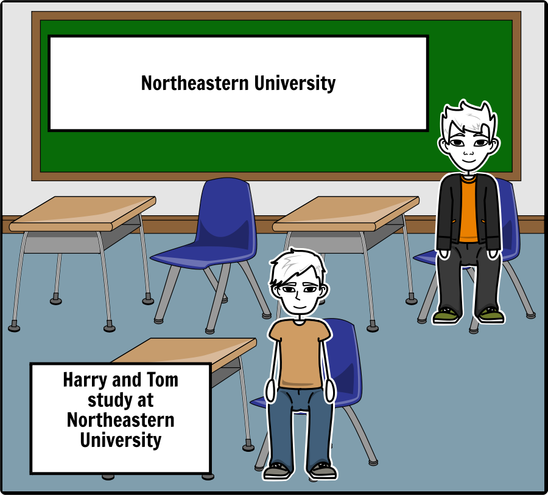
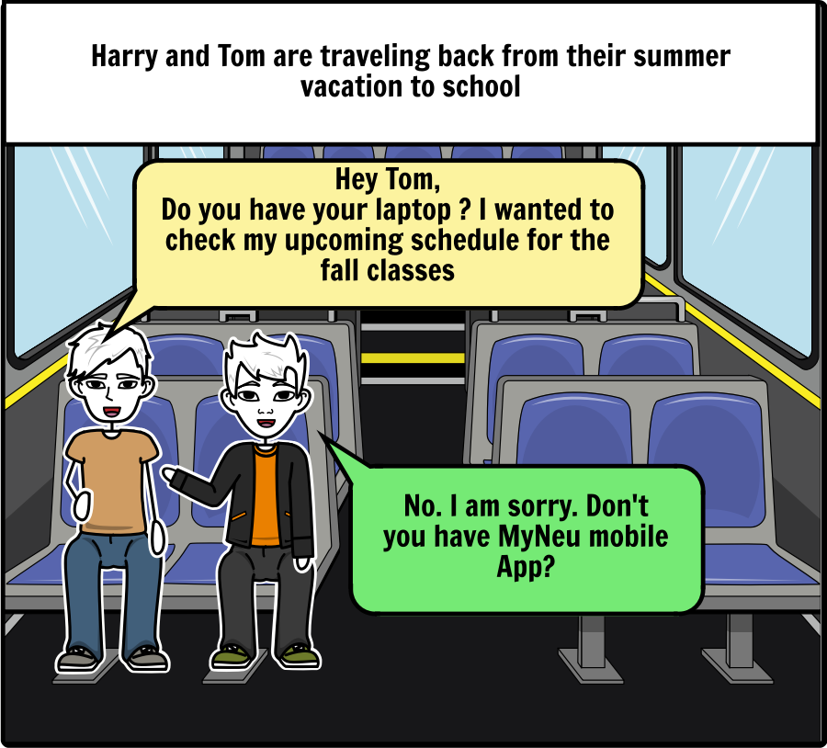
Storyboarding - StoryboardThat

Slide 5
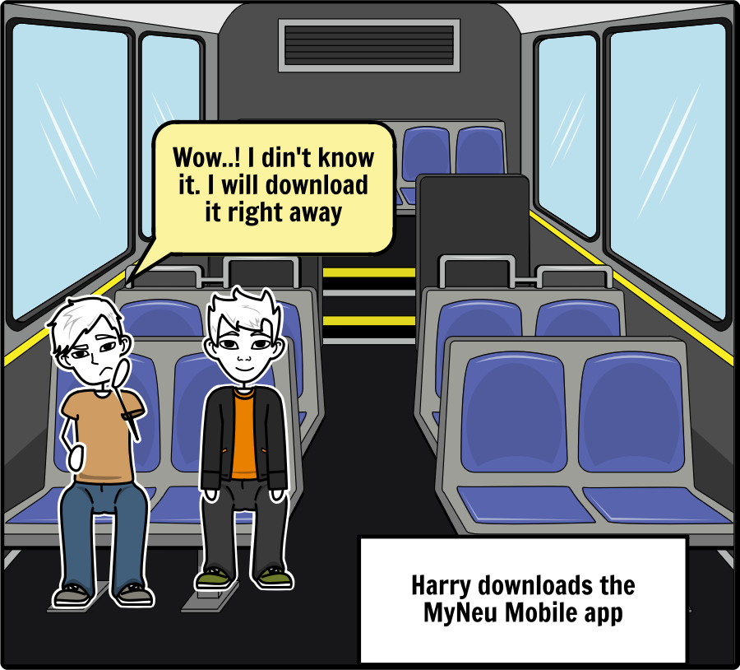
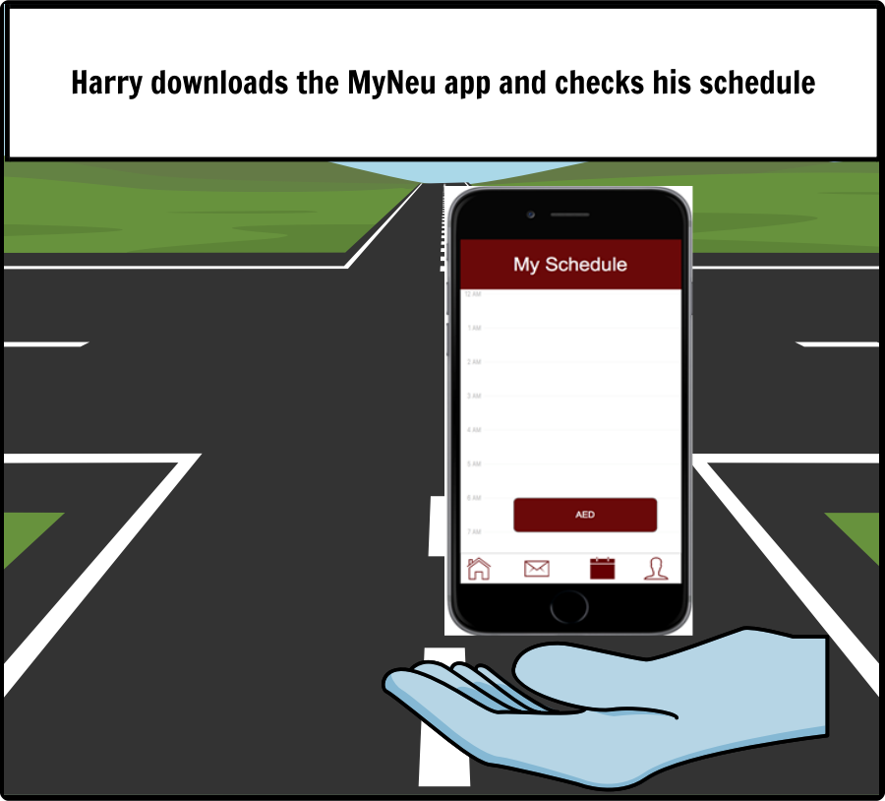

Slide 6
Card sorting
A card sort is a user centered design method for increasing a system’s findability.
The process involves sorting a series of cards, each labeled with a piece of content or functionality, into groups that make sense to users or participants
Card sorting answers the main question : Are people finding what they came for?
Who best to answer this question other than the user himself
Our goal for card sorting is to validate the categories and to discover new categories

Slide 7
Cards
View Course Catalog
View Transcripts
Bookstore
Forgot Password
Login
Course Registration
Loan/view borrowed books
Apply for Job
View Gradebook
My Schedule
My Finance Account
Employment Forms
View Bills
Reserve a room
View status of applied jobs
Find A Job
Direct Deposit Forms
Financial Counseling
Contact Us
Lecture Material
View Financial Aid status
Lecture Recording
View lecture material
My Profile
View emails
Search for library room
Health Insurance Requests
Apply for Financial Aid
Fill timesheet

Slide 8
Qualitative Analysis
User comments
Did not understand where to place student forms
Card name Payments was not clear

Slide 9
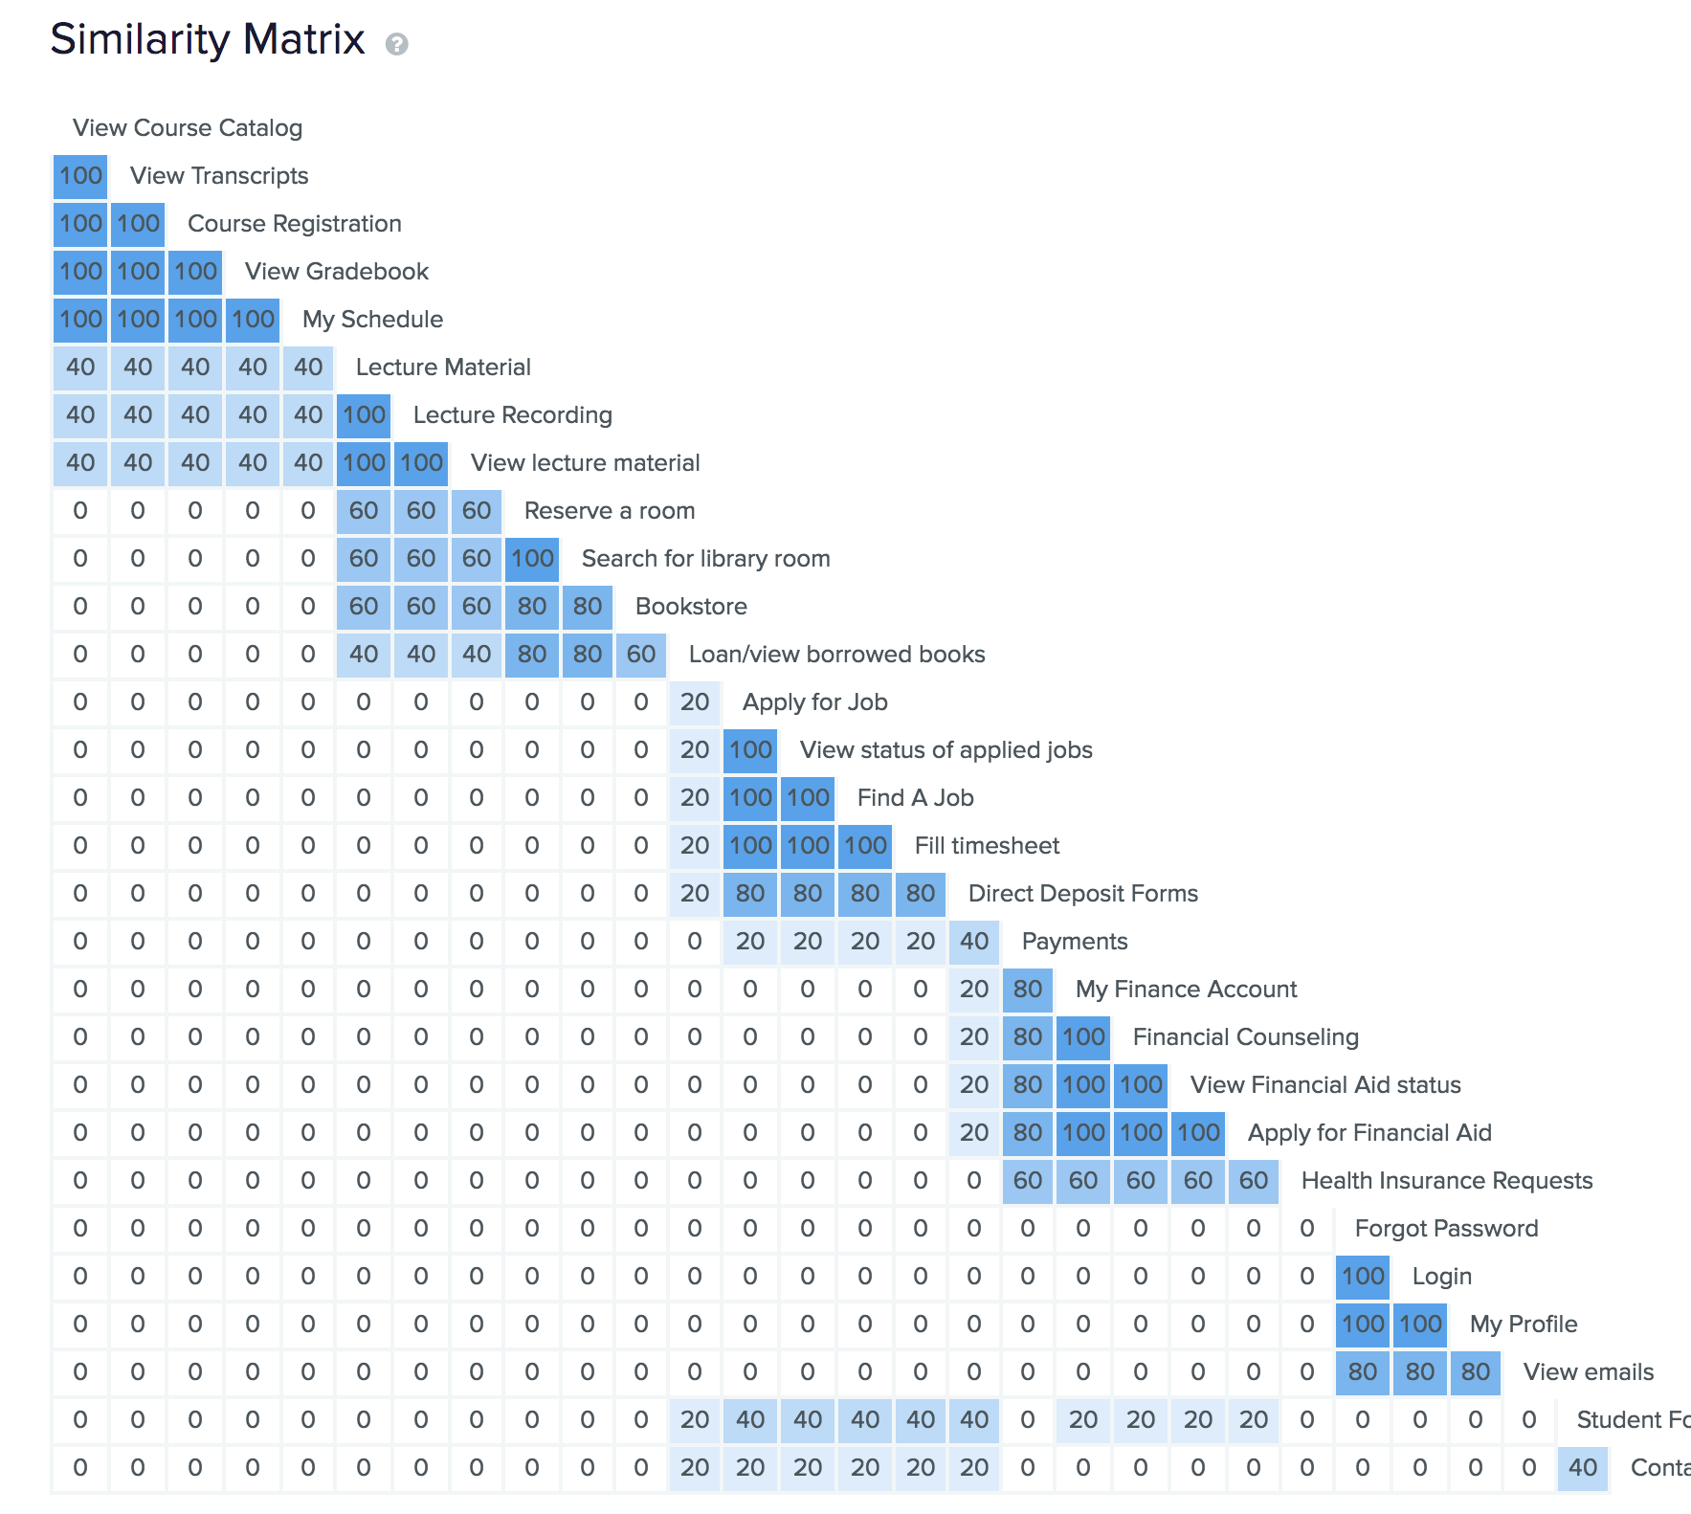
Quantitative Analysis
Similarity matrix displays the percentage that any one card was grouped with another card
In our case the matrix confirms the categorization that we have followed
Changes to IA based on Similarity Matrix
Help was moved from the navigation bar to the footer

Slide 10
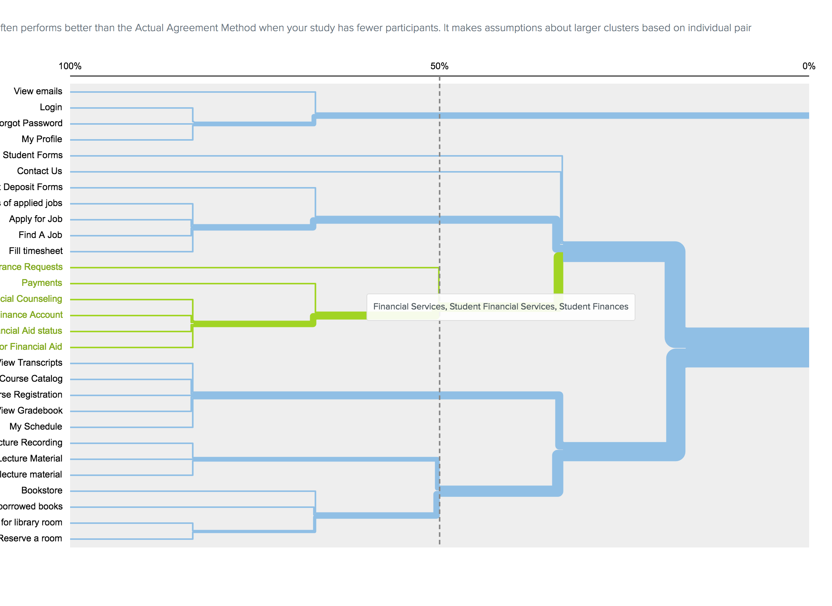
Hierarchical Cluster Analysis
Graphical Display using Dendrogram
Shorter branches are strongest
Weaker relationships are found far away

Slide 11
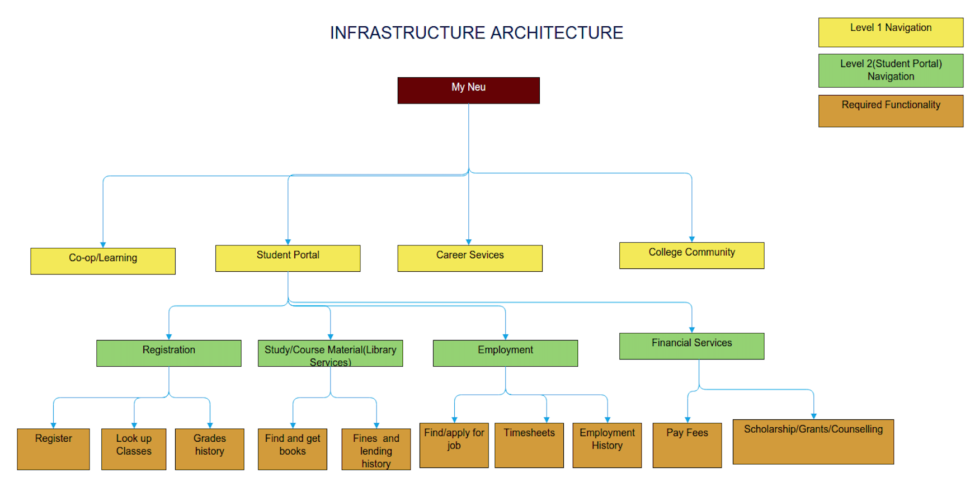
Information architecture- Website

Slide 12
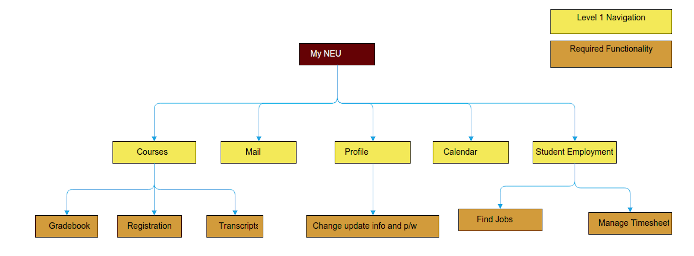
Information Architecture - Mobile

Slide 13
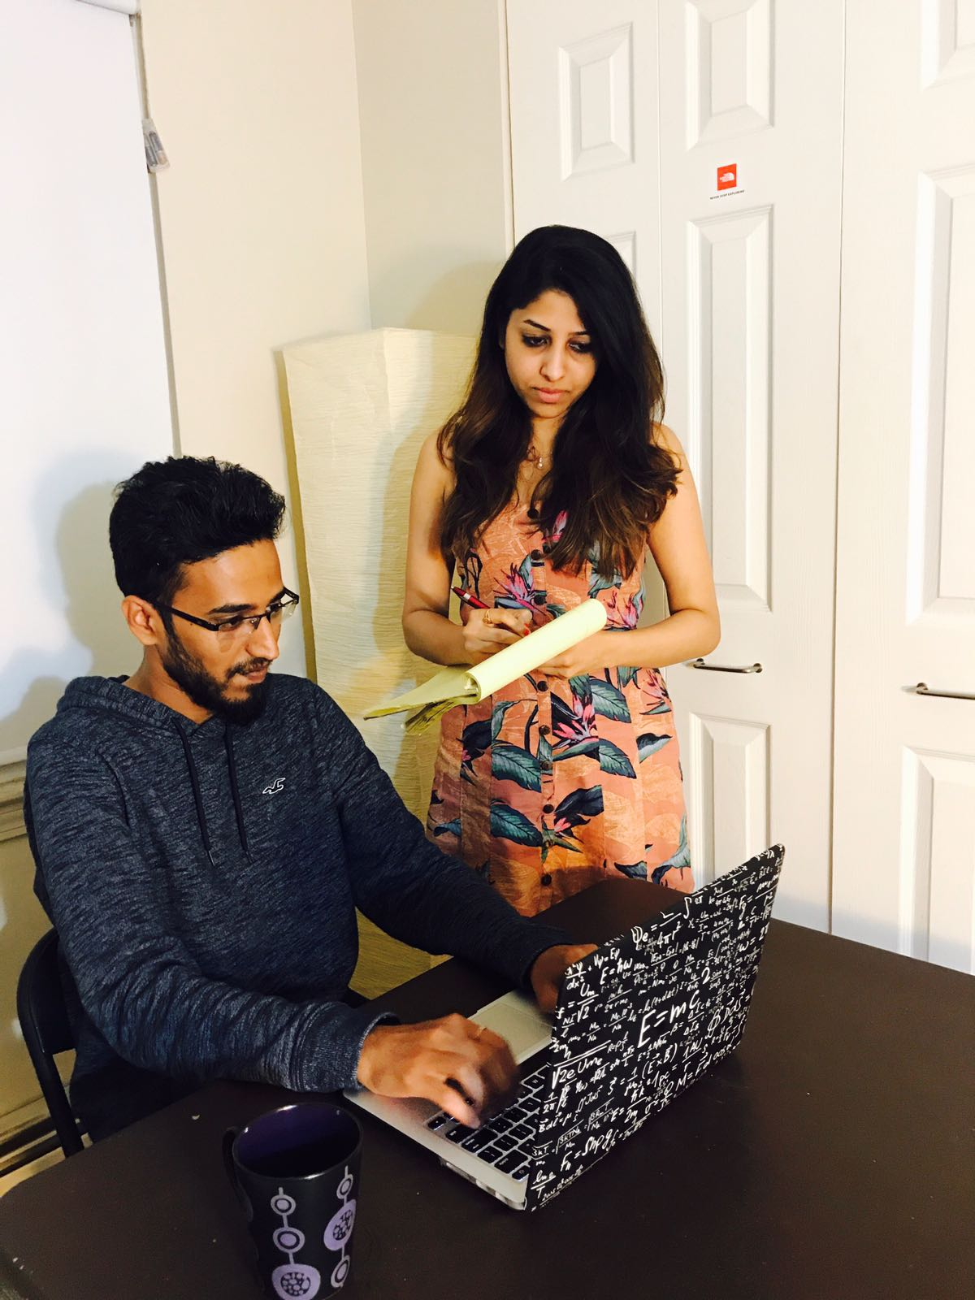
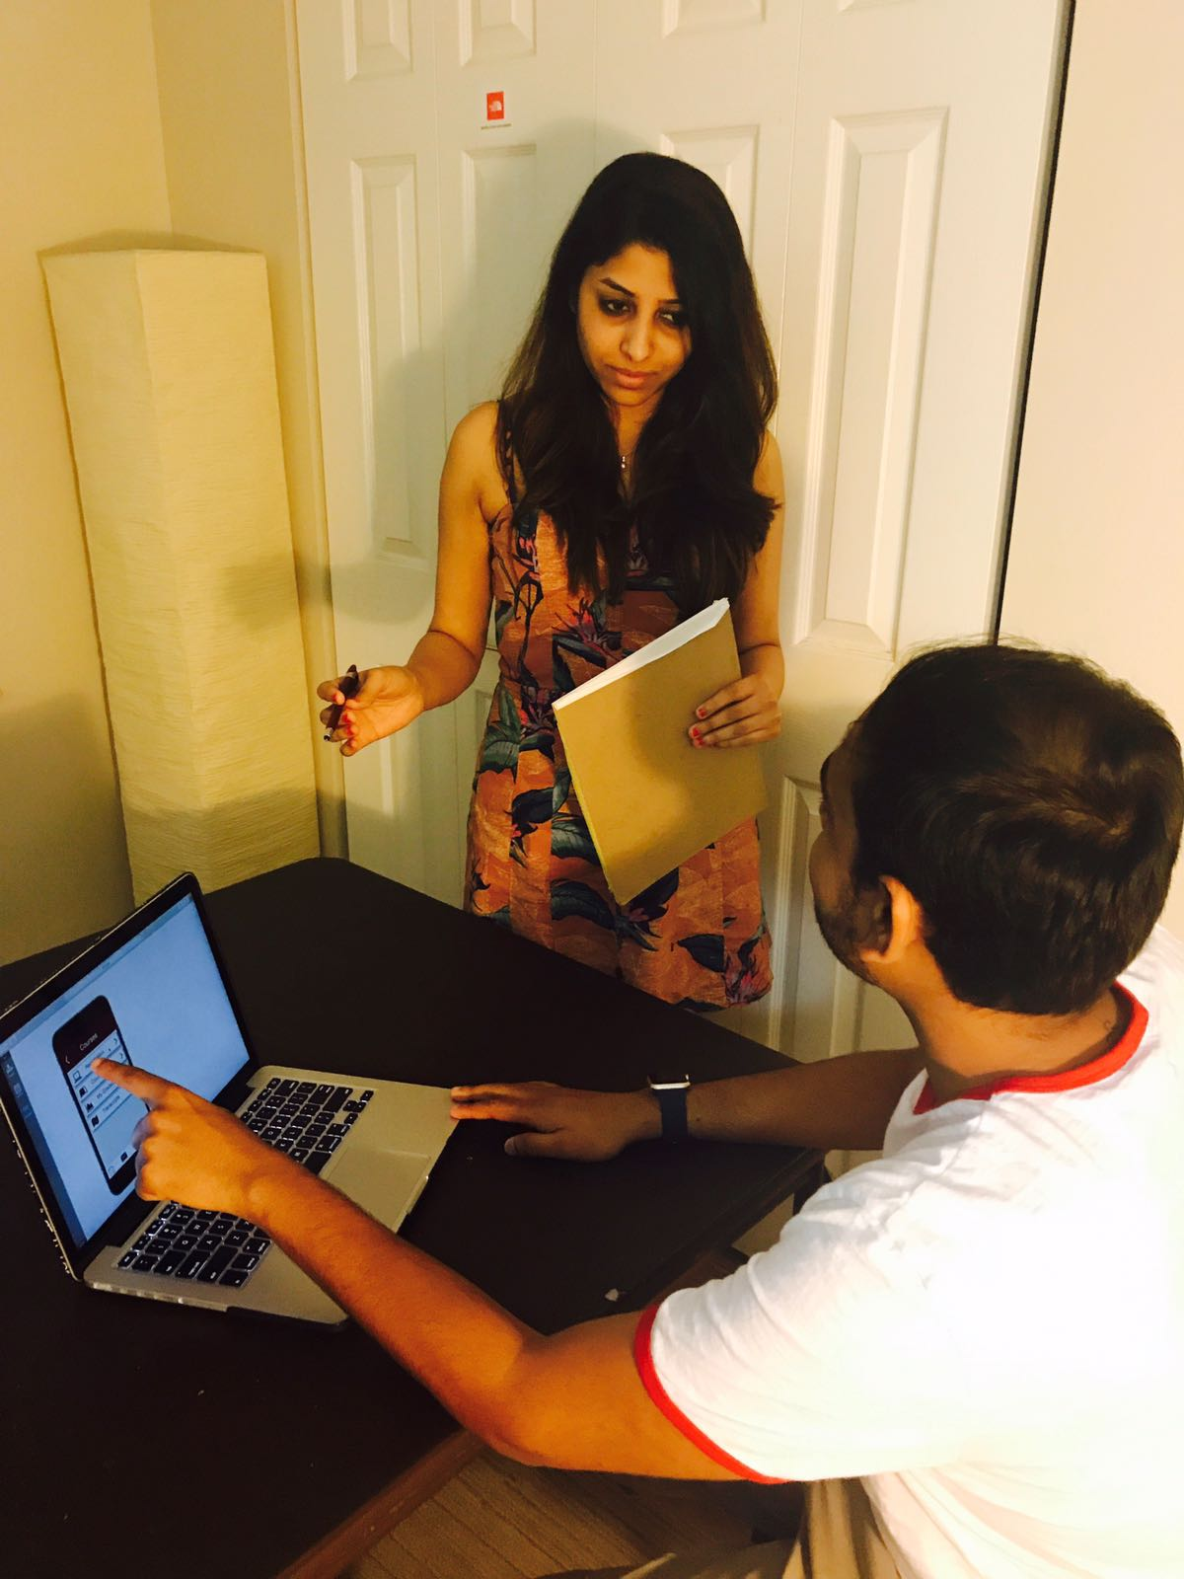
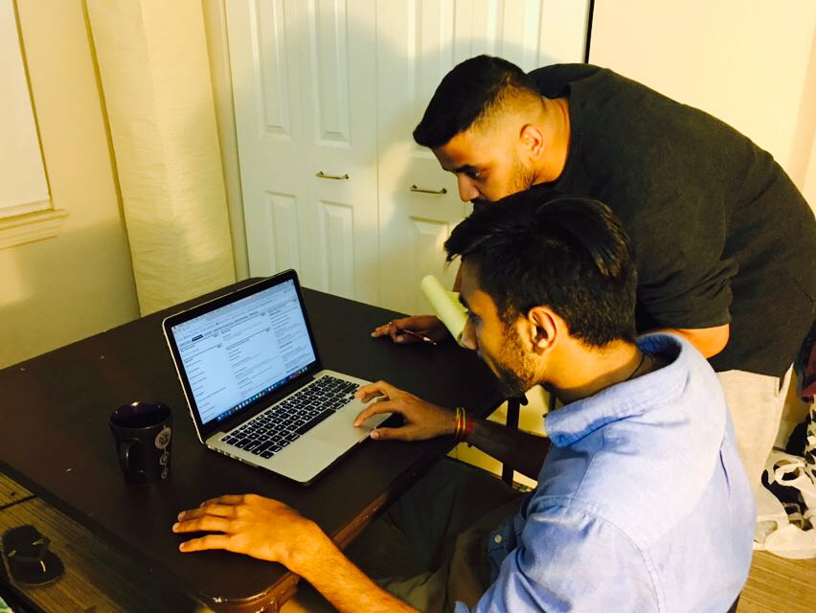
Usability testing
Participant Demographic
Total 3 participants
Average Age 23 - 26
Three of them used MyNeu before and two were new to the website.
2 of them were familiar with the MyNeu website and 1 had never used MyNeu
Most said they would also prefer having a mobile application along with the website for quick (anywhere access)

Slide 14
Usability testing Contd..
User Tasks
You want to know your current registration status. Browse through the MyNeu portal to see if you can find your current status
You want to browse and select a course for current semester. See if you can browse through the iOS mobile application to add a new course
You have your project presentation scheduled and you need to prepare for it by booking a study room in the library. See if you can browse through the MyNeu portal and book a room
Suppose you want to drop you current course and select some other course. See if you can drop you current registered course using iOS mobile application

Slide 15
Usability testing Contd..
Qualitative analysis
Task 1
New user started by searching for registration from MyNEU central.
User comments:
“I would prefer if there would be a search option instead of navigating through out”
“It would be easy for me if I could drop or add the course directly while I searched”
Task 2
Users browsed the course and could not find a direct option to add a new course in current prototype
Users lost track of the course details while going back to registration again after the lookup
User Comments:
“I would rather have both lookup and registration lying together”

Slide 16
Usability testing Contd..
Qualitative analysis
Task 3
User tried to search for library tab under MyNeu home page
There were lot of information on self service page. Users got lost while searching for the links and skipped the Library Link
“It is time consuming for me to open another link and log in the details again for booking a room”
Task 4
Users went to drop the course and then browsed again to look for a course and then registered
“I would prefer a quick look at my registered courses”

Slide 17
Cognitive Walk Through
Happy Path | Old Path | New Path
Viewing my schedule (iOS) | Login into the application Tap on course registration Tap on my schedule Choose the semester Click on view schedule | Login into the Application Tap on My Schedule from bottom navigation
Registration of course | Click on course registration Select a term Fill in the details Look for crn by clicking class search Lookup program Click on view details Click on register | Click on the course from the home page From the side bar click on registration Enter the fields and Click on search. Click on plus sign to add

Slide 18
Recommendations
Better name could be provided to SELF SERVICE which closely relate to the functionalities it deals with
Quick Search bar on top at the website would help to ease out the navigation process
Instead of showing lot of data on one screen, reduce the display content and provide a header bar
Side navigation would show often accessed options
Provide Bottom navigation for quick access to My Schedule in IOS Application
A segmented control would be a better option to switch between Add/Drop course and my course in iOS application

Slide 19
Eye tracking analysis
Tool: Inspectlet (Heat Map and User behavior)
Task: “You want to register for a course. Go to Course Registration page and add a new course”
Analysis based on
Approximately 69% of the user switched between the Add/Drop courses and My Courses
Most of the users did not interacted much with the accordion. They only clicked on the subjects which were of their interest and not all of them.

Slide 20
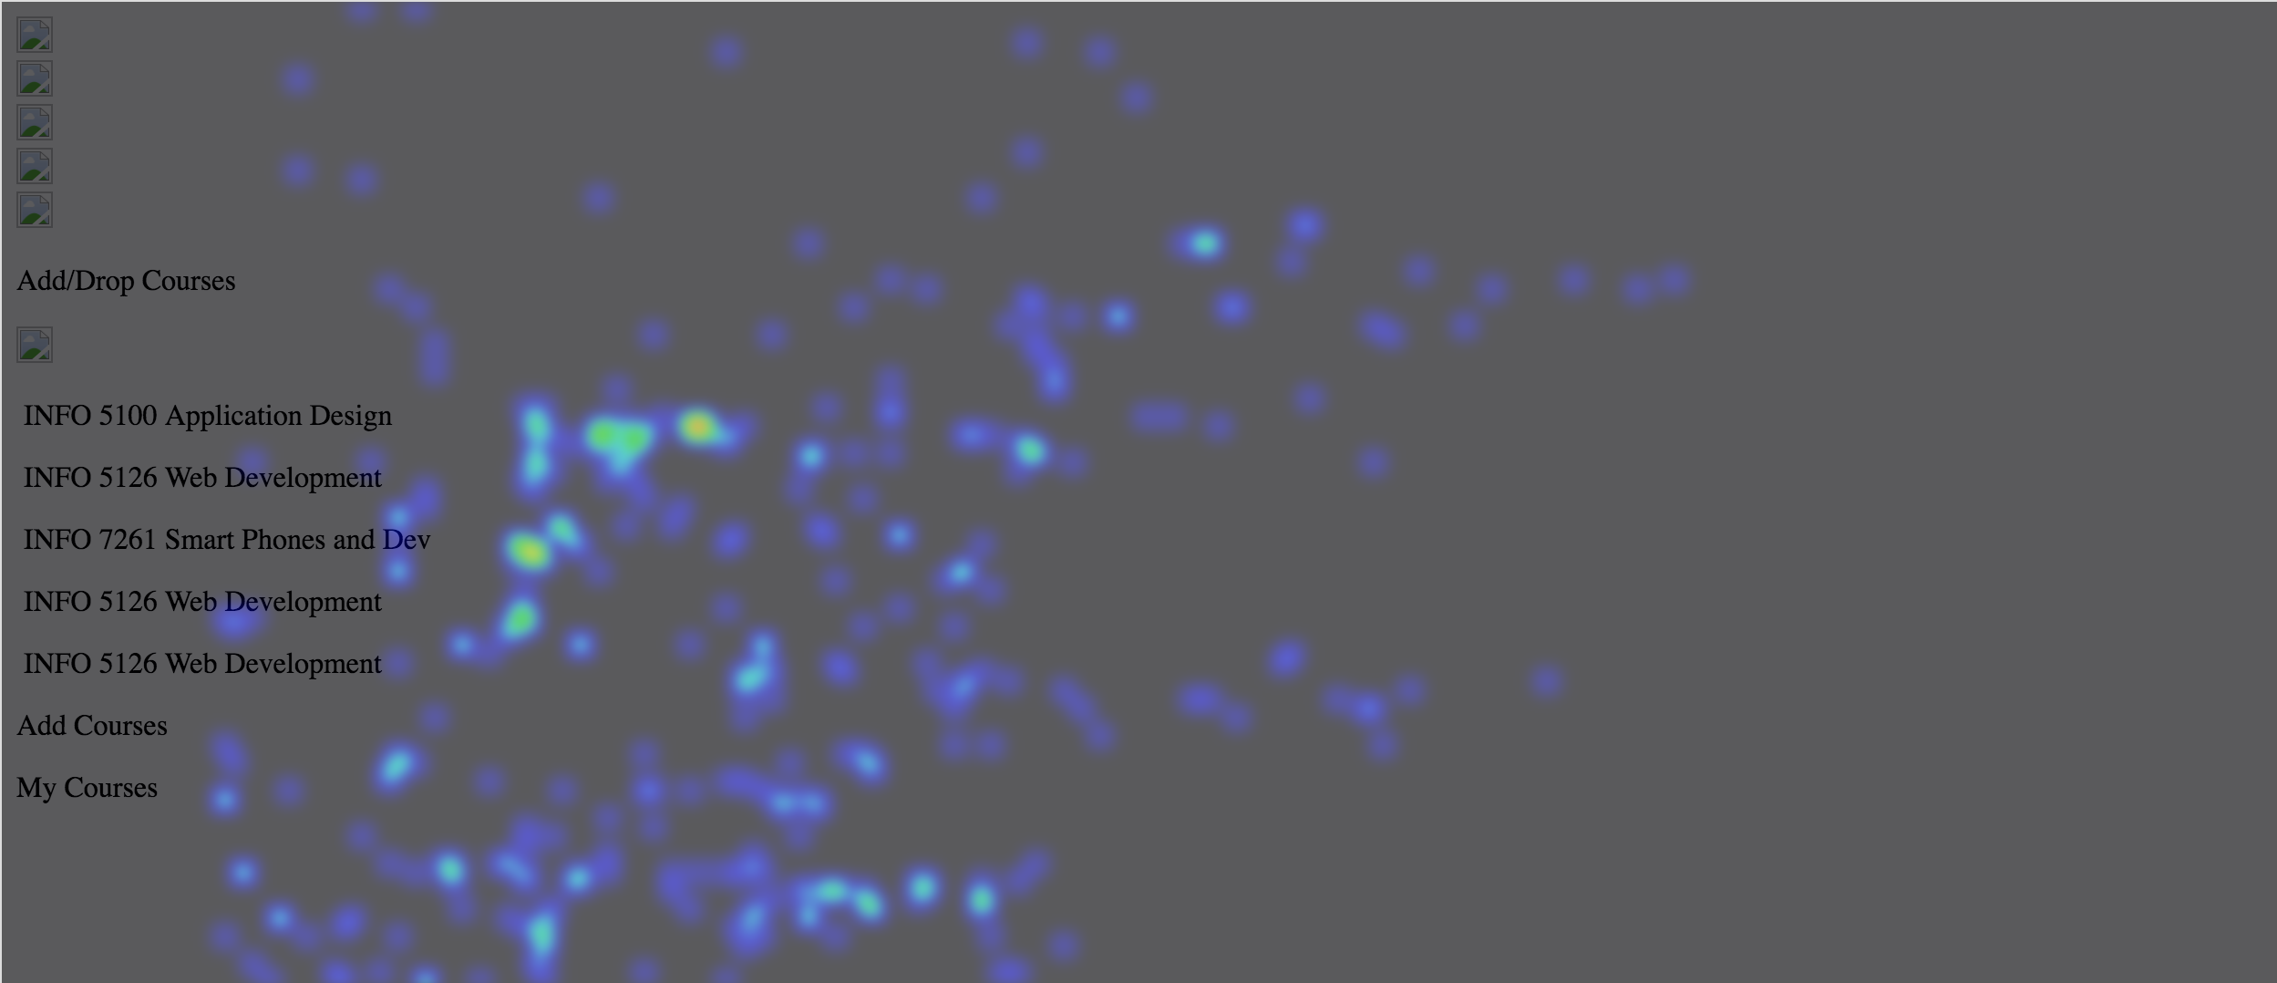
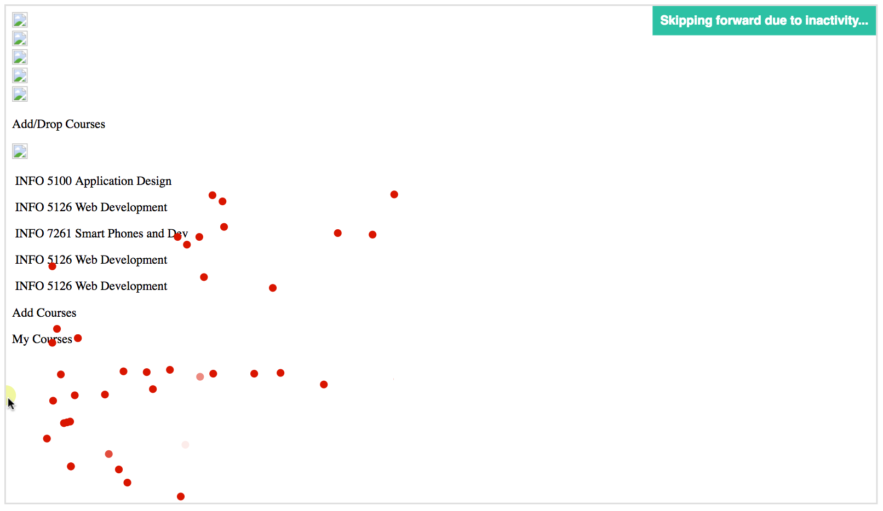
Heat Map and User Behavior
Heat Map
User Behavior

Slide 21
Prototype
MyNeu Mobile Application (iOS)
http://2p73ep.axshare.com/#c=2
MyNeu Web
http://azb3sh.axshare.com/#c=2

Slide 22
Click stream analysis & a/b testing

Slide 23
User feedback
Performed a survey on the new MyNeu wireframes.
Link to feedback survey
https://docs.google.com/forms/d/e/1FAIpQLSccYzNR0BsVWQlJHwsUv6WhT4u33aT2Tb1tMWvlQGvUY0-oOA/viewform?c=0&w=1

Slide 24
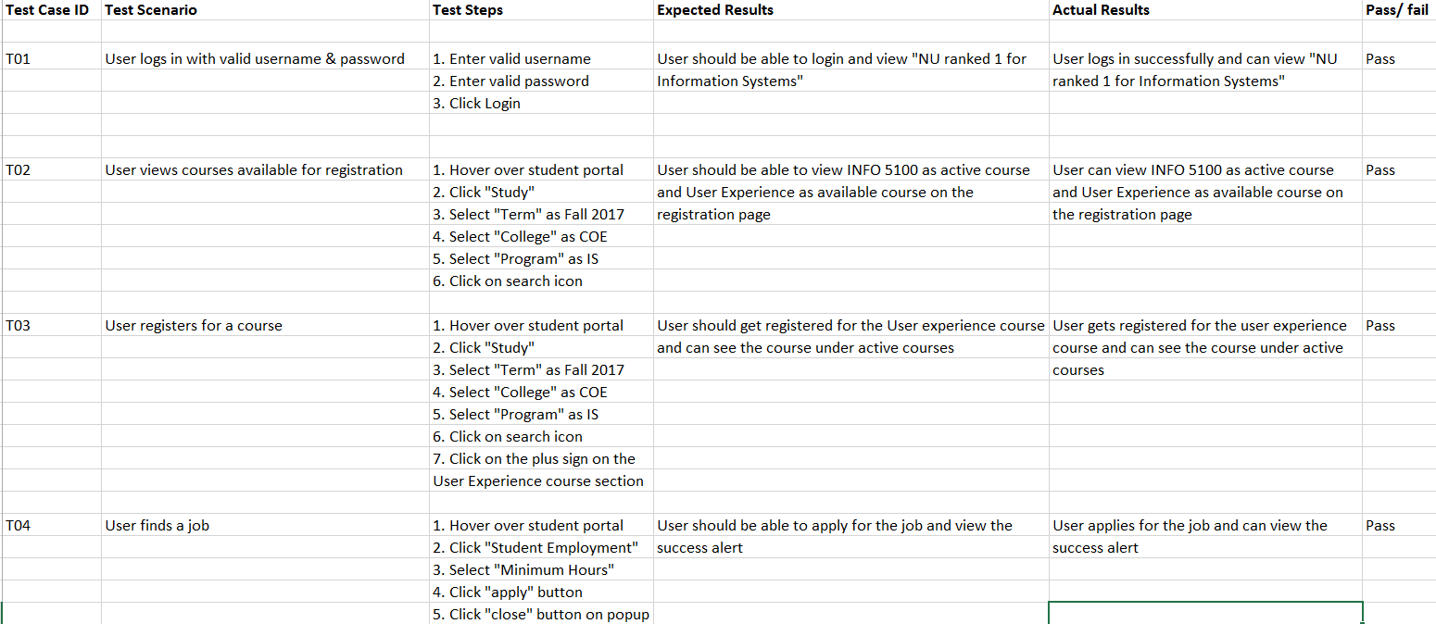
Selenium test cases

Slide 25
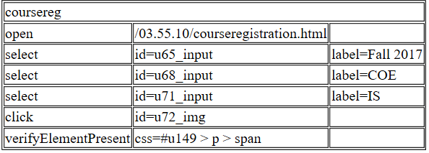
Test case in Selenium IDE

Slide 26
Future scope
Suggestions received from the user feedback survey can be incorporated in the next version to better match user expectations.
Redesign the website to improve other functionalities such as blackboard, career development portal etc.
Develop the existing prototype for web and mobile application.

Slide 27
Tools
Google Forms
Xtensio
Moqups
Axure
Selenium IDE
Inspectlet
StoryboardThat
OptimalWorkshop

Slide 28
References
www.uxdesign.gov
https://uxdesign.cc/
https://www.nngroup.com/
Guru99.com website
https://www.interaction-design.org/literature/book/the-encyclopedia-of-human-computer-interaction-2nd-ed/card-sorting
https://www.nngroup.com/articles/usability-101-introduction-to-usability/
https://www.nngroup.com/articles/ten-usability-heuristics/
https://www.kaushik.net/avinash/lab-usability-testing-what-why-how-much/
http://www.bentley.edu/centers/user-experience-center/usability-labs
https://msdn.microsoft.com/en-us/library/windows/desktop/aa468538.aspx
https://measuringu.com/he-cw/

Slide 29
Thank you!!

